Slide 1
Corporate Sponsorship
©2014 Dharma Civilization Foundation. All rights reserved.

Slide 2
“Shanti – A Journey of Peace”
Shanti in Sanskrit means “Peace”. Shanti is a spectacular multi-media musical production, featuring over 250 Bay Area artists, that integrates western forms of music, choir, dance and orchestral symphony with Indian musical and dance elements.
Shanti is an expansive and collaborative performance that explores the meaning and message of peace, joy, and the interconnectedness of all humanity. It is the ultimate confluence of peoples, cultures and religions; It celebrates the diversity that characterizes our global era through the language of music and dance. Shanti embodies the possibilities for concord amongst the world’s civilizations rather than their clash.
Shanti has wowed audiences for over 10 years now, since its triumphant opening in Cincinnati, Ohio. It is being performed for the first time in the Bay Area, to an anticipated audience of about 6200 people across 3 performances.
©2014 Dharma Civilization Foundation. All rights reserved.

Slide 3
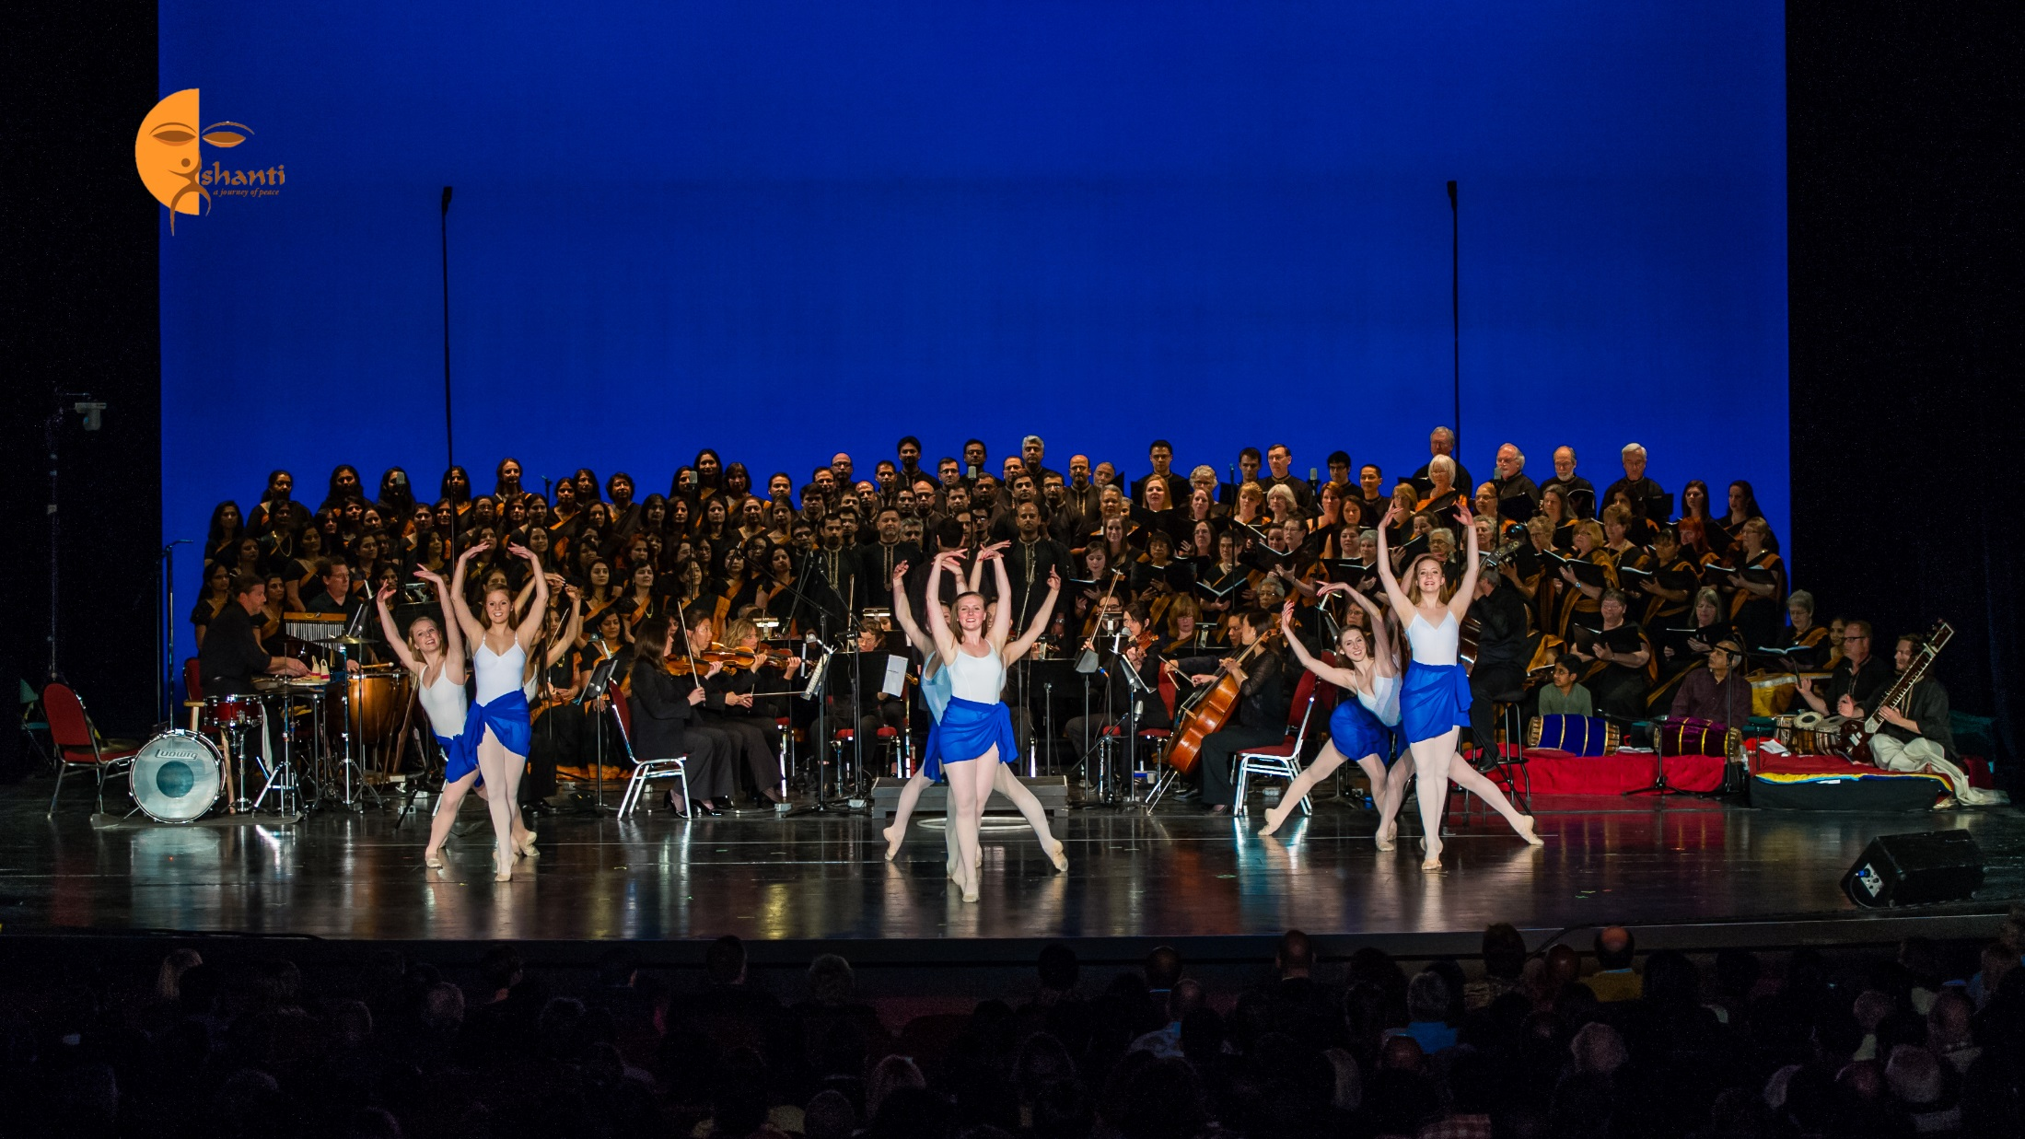
Shanti – An Overview
An Acclaimed Multi-Media Musical Performance
A musical score that cuts across cultures
In the Bay Area for the first time !
©2014 Dharma Civilization Foundation. All rights reserved.

Slide 4
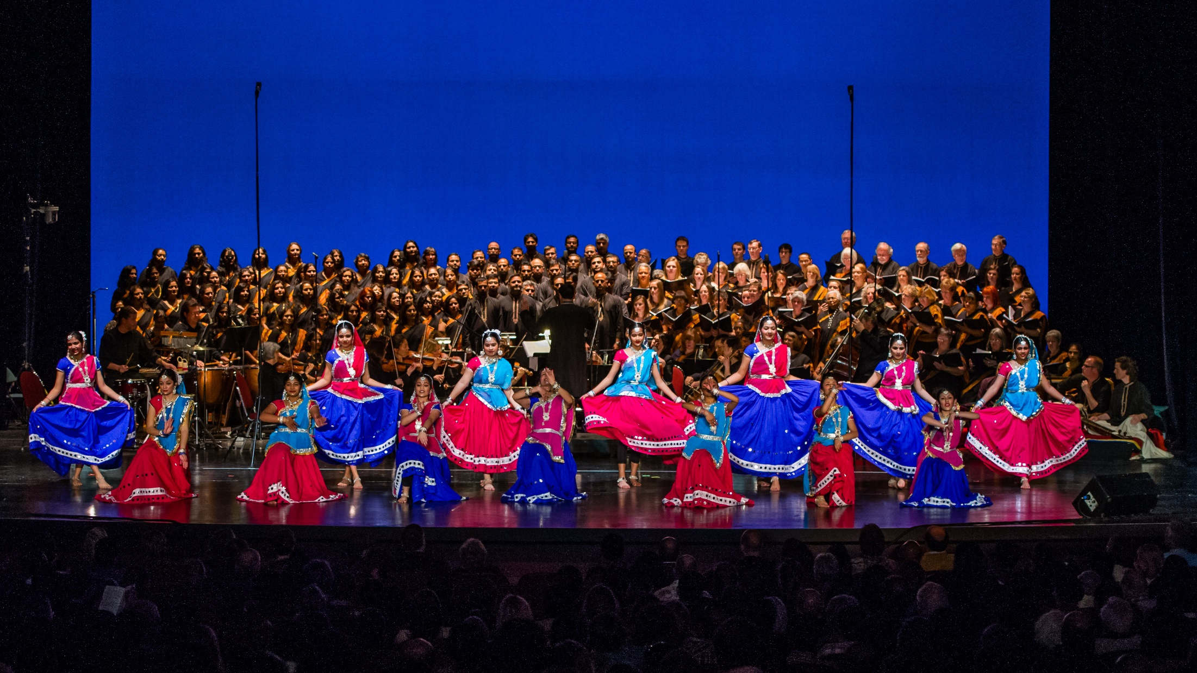
Shanti – A Journey of Peace
Explores the Message of Peace and Joy
And the inter-connectedness
of humanity
Shanti is a confluence of peoples, cultures and religions
©2014 Dharma Civilization Foundation. All rights reserved.

Slide 5
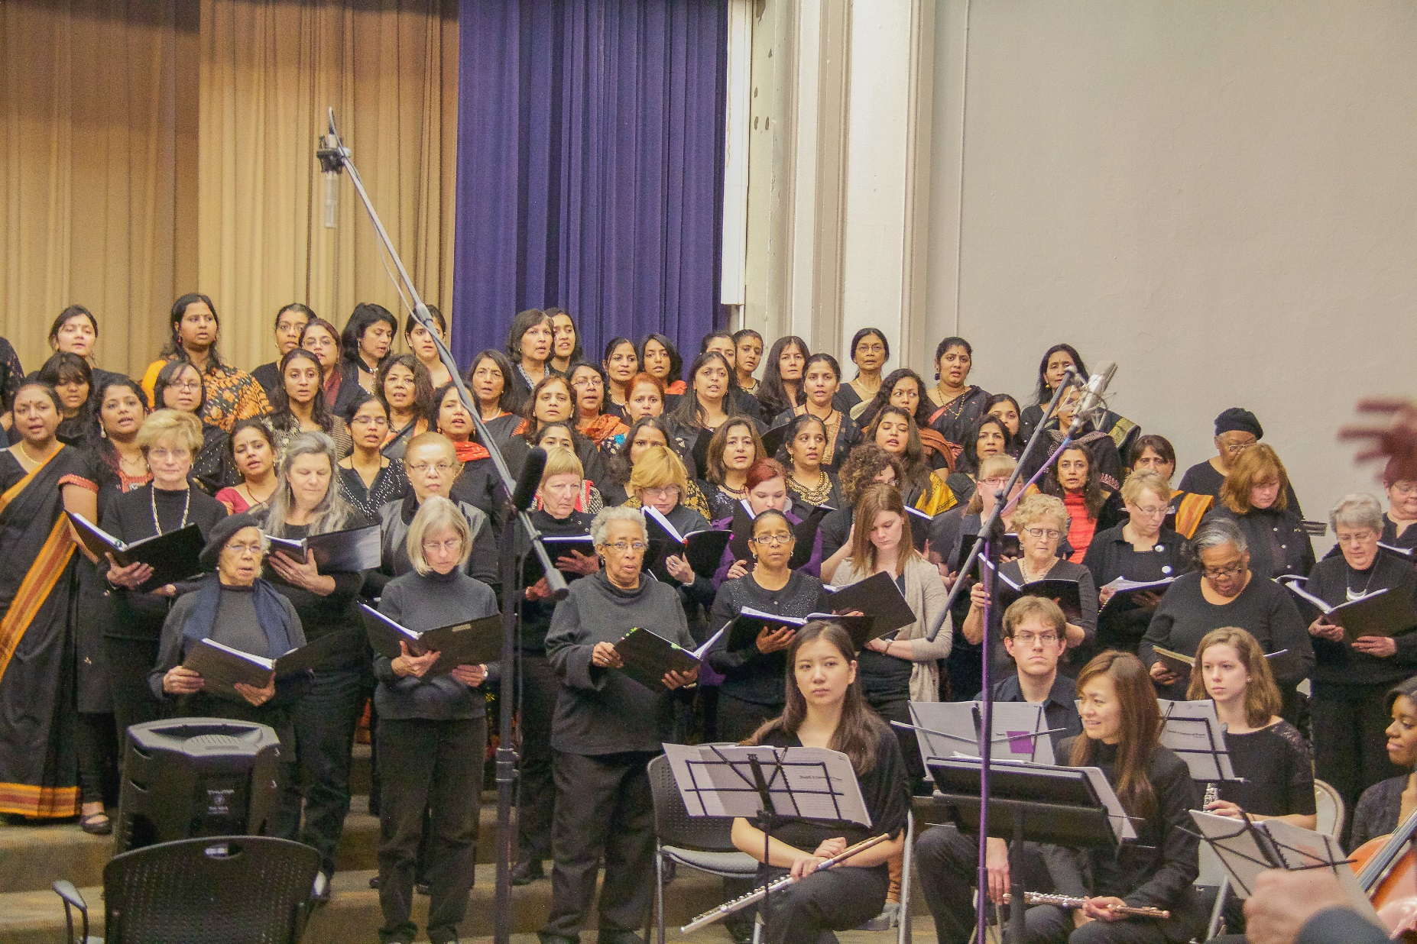
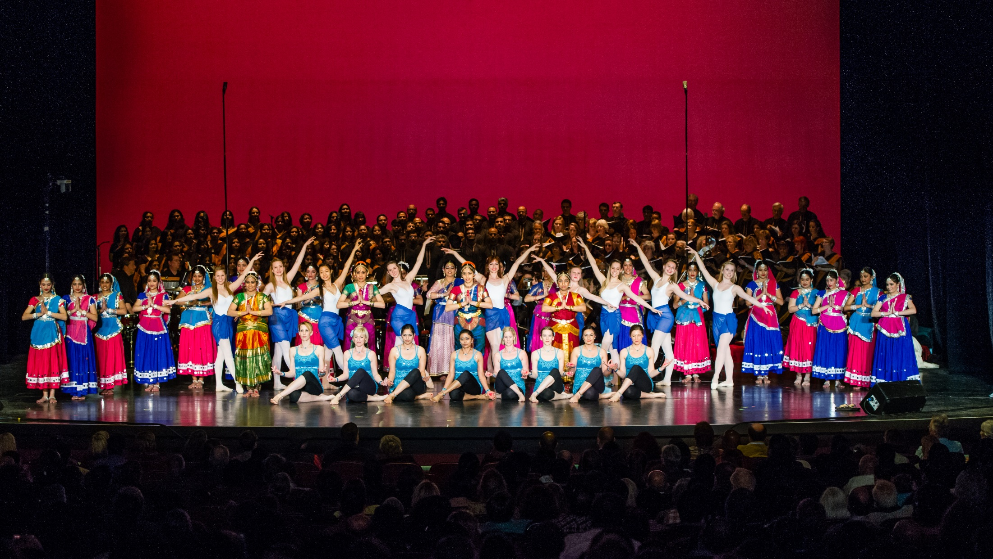
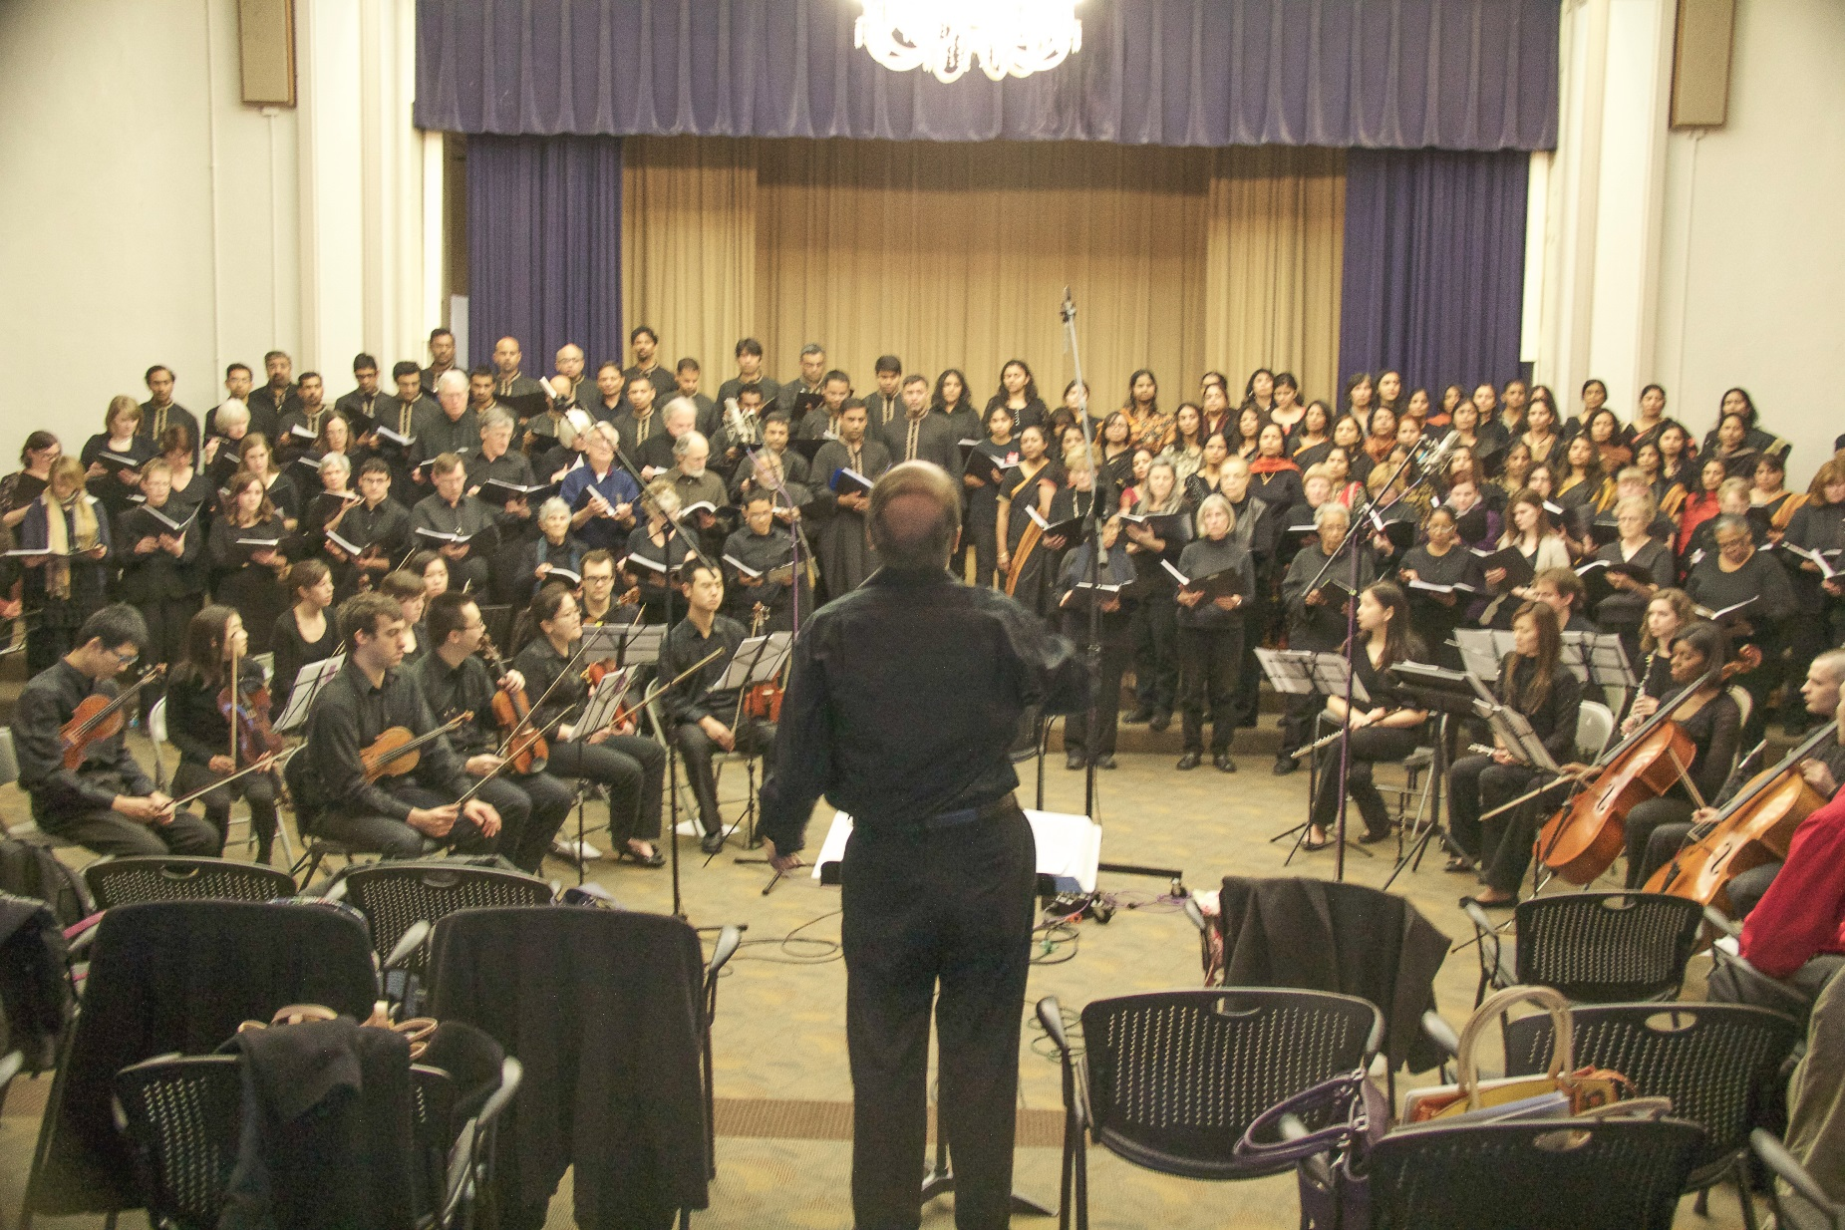
Shanti – A Celebration of Diversity
A Ground-Breaking Creation
in the History of World Music
Performed entirely by Local Bay Area Artists
©2014 Dharma Civilization Foundation. All rights reserved.

Slide 6
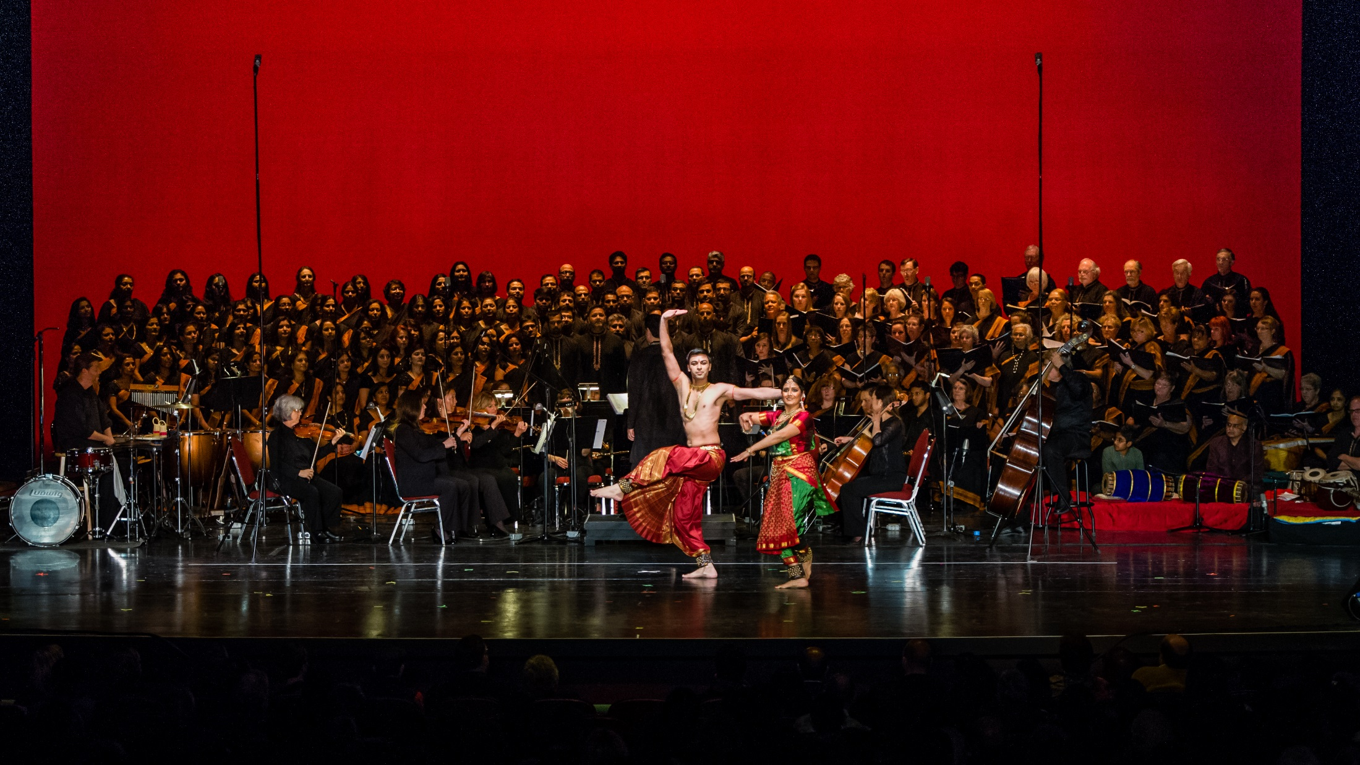
Shanti – A One of a kind experience
Integrates the Dance, Music & Images of India
With a Western Orchestral Symphony and Dance
Shanti is a spectacular, mesmerizing and moving experience
©2014 Dharma Civilization Foundation. All rights reserved.

Slide 7
Shanti – Facts
Performed by 250 Musicians & Dancers
Performed In the Bay Area for the first time
Premiered in Cincinnati in 2004
Has wowed audiences for over 10 years
3 performances in the Bay Area - 2016
Expected Audience of over 6200
April 30th - Flint Center, Cupertino
May 21st - Interstake Center, Oakland
©2014 Dharma Civilization Foundation. All rights reserved.

Slide 8
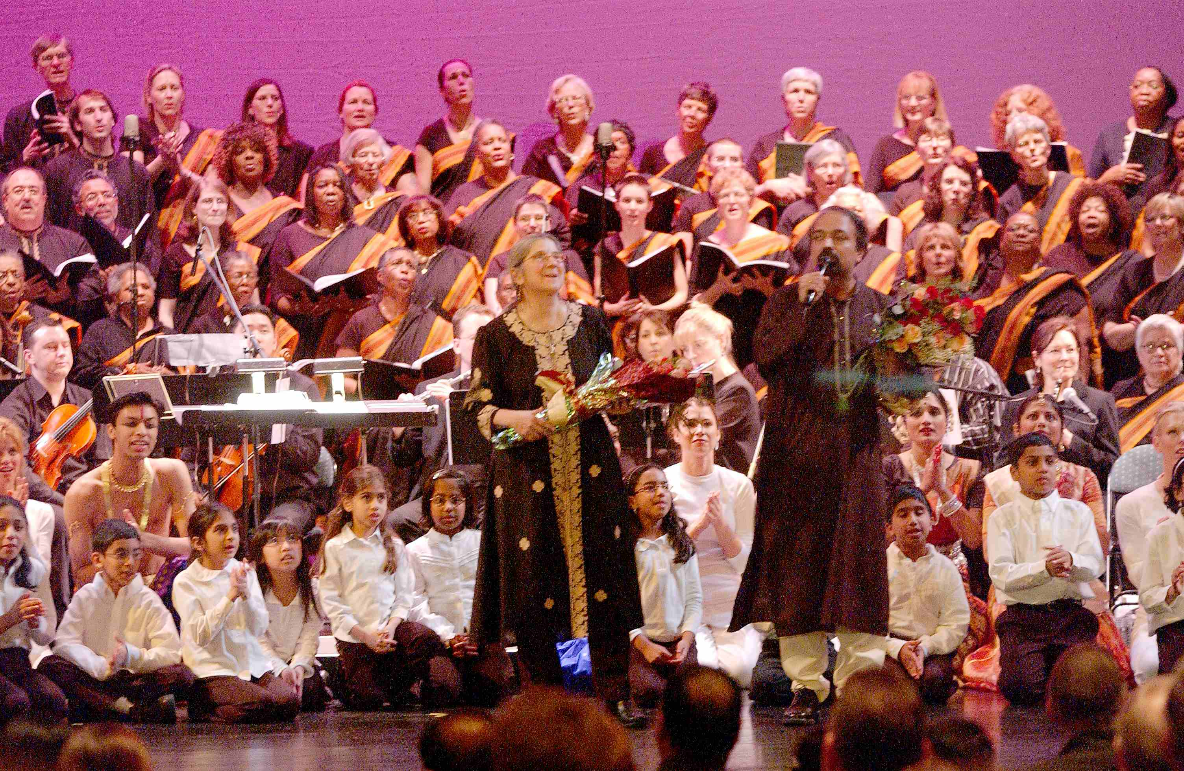
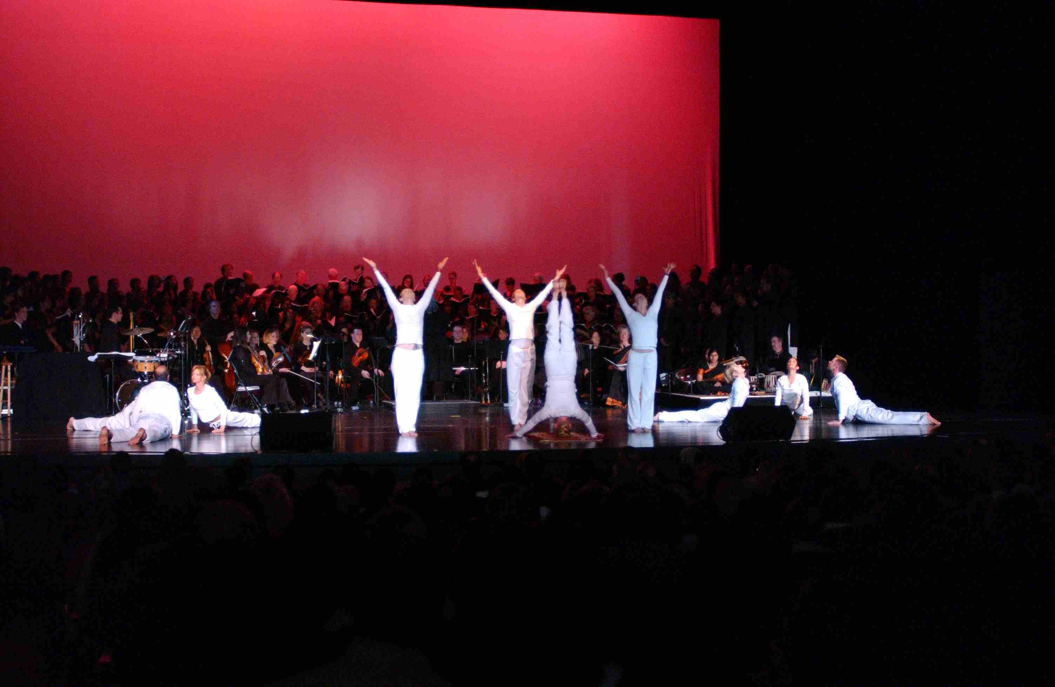
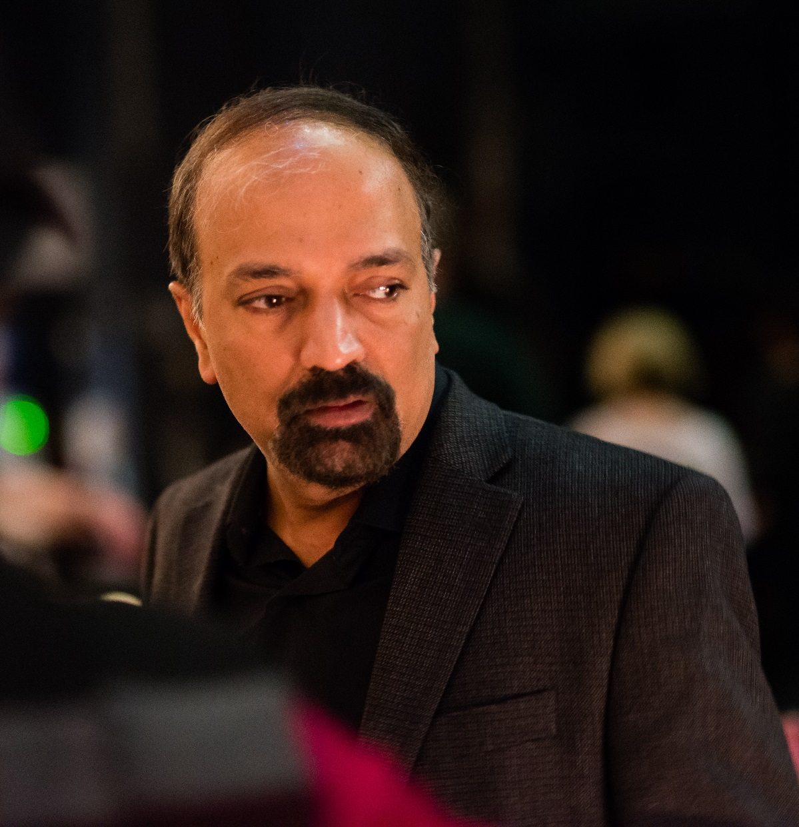
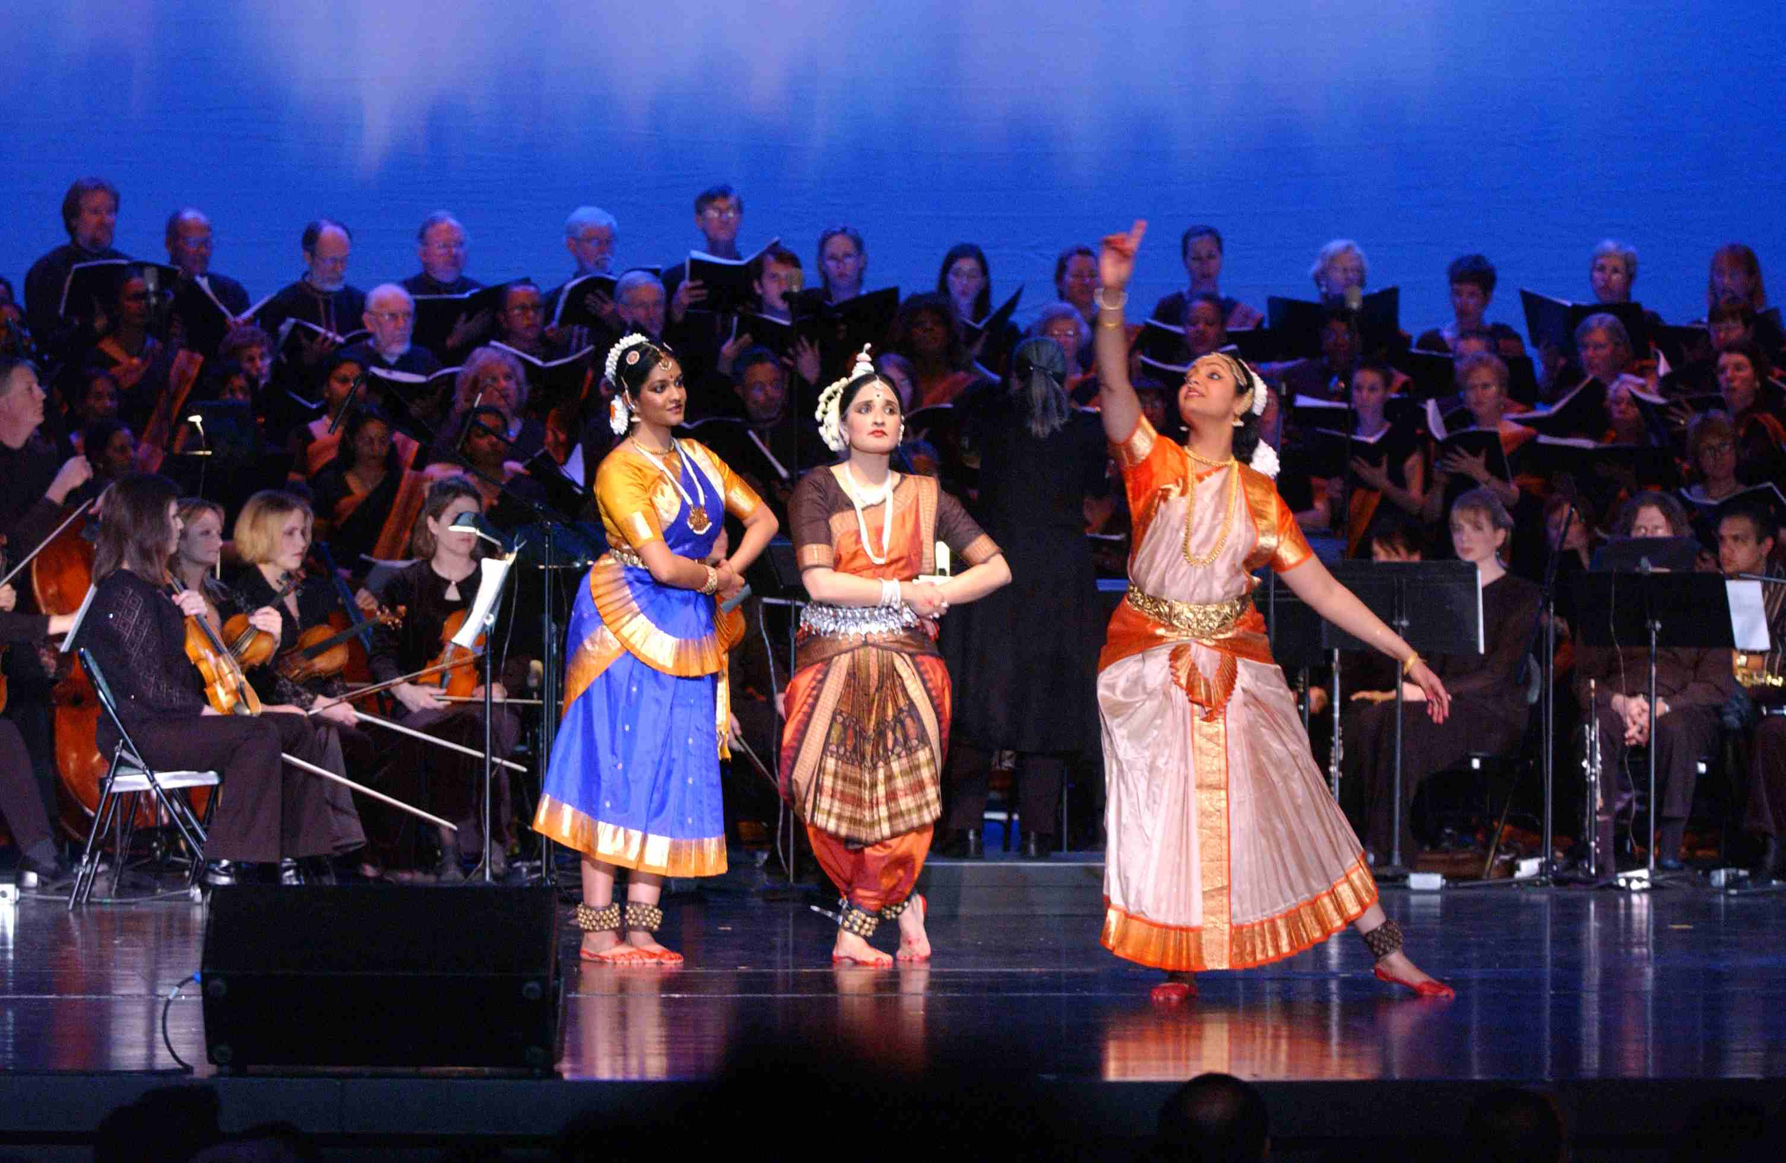
Shanti is a celebration of diversity
In the language of Music and Dance
Click Here to see a 90 second preview of Shanti
Composed by Award winning composer Dr. Kannikeswaran
©2014 Dharma Civilization Foundation. All rights reserved.

Slide 9
Shanti – Marketing Strategy
Time Lines
Dec 2015
Jan 2016
Feb 2016
Mar 2016
Apr 2016
May 2016
Outreach
Online
Video
Events
Print
Radio
Movies
Billboard
TV
©2014 Dharma Civilization Foundation. All rights reserved.

Slide 10
Shanti – Corporate Sponsorship Opportunity
Category | Dates | Audience* | Location
Shanti Performance | April 30th | 4600 | Flint Center, Cupertino
Shanti Performance | May 21st | 1600 | Interstake Auditorium, Oakland
Online Marketing | Thru May 21 | 50,000+ | Web Site, Social Media, E-Mails
Video Promotions | Thru May 21 | 50,000+ | Web Site, Social Media, E-Mails
Events (Promotional) | Jan – May | 5000 | Various Bay Area Locations
Print Media | Jan – May | 100,000+ | Posters and Publications
Radio | Jan – May | 1,000,000+ | Ad’s + Promotional Programs
Movies | Apr – May | 2,000,000+ | 3 Theaters in Bay Area
Bill Boards | Apr – May | 6,000,000+ | I-101 and I-880 (2+ Locations)
TV Advertisements | Apr – May | 1,000,000+ | Zee TV and TV Asia (45 days)
Event Booklet Ad’s | Apr – May | 5000 | Full Page + Half Page Ad’s
* - An Estimate of the total impressions that each line item will create
©2014 Dharma Civilization Foundation. All rights reserved.

Slide 11
Shanti – Corporate Sponsorship Levels
 | Sponsorship Levels | Amount | # Available
1 | Platinum | $50,000 | Up to 4
2 | Diamond | $25,000 | Up to 8
3 | Gold | $10,000 | Up to 10
4 | Silver | N/A | Up to 50
Details on each Sponsorship Level is subsequent pages
©2014 Dharma Civilization Foundation. All rights reserved.

Slide 12
Shanti – Platinum Sponsorship
Sponsorship Amount = $50,000
Item # | Item Description | Duration
1* | Recognition on a Large Bill-board on US-101 or 880 | April & May
2* | Movie Theater mention in all three Movie Theaters | April & May
3 | Recognition on all special Shanti Radio Events | Jan – May
4 | 30 Second Video Advertisement at the Event | Apr 30 & May 21
5 | Full Page Color Ad. in the Event Publication | Apr 30 & May 21
6 | Acknowledgement via a Slide Show at the Event | Apr 30 & May 21
7 | Recognition on Shanti related Web Site pages | Dec - May
8 | Recognition on all Shanti E-Mails & Newsletters | Dec - May
9 | 15% off all tickets for all members + 10 Free tickets | Apr 30 or May 21
* - One of the above: A Platinum Sponsor will get exclusive mention in one media
©2014 Dharma Civilization Foundation. All rights reserved.

Slide 13
Shanti – Diamond Sponsorship
Sponsorship Amount = $25,000
Item # | Item Description | Duration
1 | Recognition on Small Bill-board on US-101 or 880 | April & May
2 | Mention in all the TV Advertisements for 1 month | April & May
3 | Recognition on all special Shanti Radio Events | Jan – May
4 | 15 Second Video Advertisement at the Event | Apr 30 & May 21
5 | Full Page Color Ad. in the Event Publication | Apr 30 & May 21
6 | Acknowledgement via a Slide Show at the Event | Apr 30 & May 21
7 | Lead Sponsor for at least 1 Shanti Promotional Event | Jan - May
8 | Recognition on Shanti related Web Site pages | Dec - May
9 | Recognition on all Shanti E-Mails and Newsletters | Dec - May
10 | 15% off all tickets for all members + 8 Free tickets | Apr 30 or May 21
©2014 Dharma Civilization Foundation. All rights reserved.

Slide 14
Shanti – Gold Sponsorship
Sponsorship Amount = $10,000
Item # | Item Description | Duration
1 | Up to 1 week of continued mentions on TV Ads | April & May
2 | Up to 1 week of continued mentions on Radio Ads | Jan thru May
3 | Recognition on all special Shanti Radio Events | Jan – May
4 | Display of Logo on all Special Posters (1000 +) | Jan thru May
5 | Full Page Advertisement in the Event Publication | Apr 30 & May 21
6 | Acknowledgement via a Slide Show at the Event | Apr 30 & May 21
7 | 2nd Sponsor for at least 1 Shanti Promotional Event | Jan - May
8 | Recognition on Shanti related Web Site pages | Dec - May
9 | Recognition on all Shanti E-Mails and Newsletters | Dec - May
10 | 15% off all tickets for all members + 6 Free tickets | Apr 30 or May 21
©2014 Dharma Civilization Foundation. All rights reserved.

Slide 15
Shanti – Silver Sponsorship
Sponsorship Amount = $0.00
Item # | Item Description | Duration
1 | Half Page Advertisement in the Event Publication | Apr 30 & May 21
2 | Recognition as a Partner via a Slide Show at the Event | Apr 30 & May 21
3 | Recognition on Shanti related Web Site pages | Dec - May
4 | 15% of all Tickets for all members | Apr 30 & May 21
A Silver Sponsor does not contribute financially to the Shanti Program. However,
they agree to partner with DCF to promote the Shanti program:
List Shanti as a sponsored program on their web site
Distribute jointly branded E-Mail Promotions for Shanti to their members (4-6 times)
Allow for a jointly branded poster to be displayed at their facility
Allow for 5 minutes of Shanti Promotion on one of their events, and enable ticket sales
©2014 Dharma Civilization Foundation. All rights reserved.

Slide 16
Sponsoring “Shanti – A Journey of Peace”
Shanti will perform to an audience of about 6200 people in the Bay Area, across 3 performances. The Marketing campaign promoting Shanti will reach millions of people.
We invite you to become a Sponsor of Shanti. We are eager to make your sponsorship of Shanti a mutually beneficial arrangement.
The Proceeds from Shanti, after expenses, will go towards supporting MA and Ph.D. programs at the Graduate Theological Union, Berkeley California, and will support both Faculty and Students.
Shanti, is being promoted by Dharma Civilization Foundation, a California based 501c3 Non-Profit organization.
©2014 Dharma Civilization Foundation. All rights reserved.

Slide 17
Become a Shanti Sponsor today
Sign up to be a Shanti Sponsor today
Help promote Shanti in your Organization / Community
Be a stakeholder for “Peace” !
©2014 Dharma Civilization Foundation. All rights reserved.

Slide 18
Shanti – A Journey of Peace
Is presented by
A California based 501c3 Non-Profit Organization

